Slide 1

KhetiSahayak.com
Aryan Hule
SAP ID:60003220213
Bhumit Mehta
SAP ID:60003220088
Aryan Sharma
SAP ID:60003220002
Chinmay Bopalkar
SAP ID:60003220217
Under the guidance of
Dr. Vinaya Sawant
Project Guide
Department of Information Technology
DJSCE
Mumbai University
2024-25

Slide 2
Problem Definition
Farmers face monopolistic rental practices, inefficient market information, and crop overproduction, reducing profitability and sustainability.To reduce this we are developing a platform to provide transparent access to rental equipment and foster knowledge sharing, empowering farmers to make informed decisions. The website helps the farmer by allowing them a Simplified access to transparent equipment rentals ,a space for farmers to share innovations and best practices and providing them with insights into crop distribution to prevent overproduction . This help promote resource accessibility, innovation sharing, and optimized crop production, leading to increased profitability, sustainable practices, and market balance in farming communities.

Slide 3
Literature Review
Survey
Monopolistic Practices: Our local village survey revealed that wealthy farmers hold a monopoly on rental equipment, charging high prices and offering limited choices for smaller farmers, further exacerbating resource scarcity.
Overproduction Issues: Many farmers tend to grow the same crops, resulting in overproduction and a sharp drop in market prices, causing significant financial losses.
Technology Gaps: While new technologies and farming policies exist, they often fail to reach remote regions effectively. Even when they do, farmers tend to be skeptical and require proof of their success before adopting these innovations.
Proportion of Farmers:
According to a 2018–19 survey, India has between 90 million and 150 million farmers, with small and marginal farmers (less than 2 hectares of land) making up approximately 86.2% of the farming population.

Slide 4
Literature Review
Limitations | Description | Solution | Techstack
Limitations of Existing Platforms for Agricultural Equipment | Farm Machinery Solutions and JFarm Services provide rental services but do not allow farmers to list their own equipment. This limits the variety of machinery available, and the platforms' reach is restricted, particularly in remote regions. | Expanding the scope of platforms to allow farmers to list their own equipment and improving their reach in rural areas could increase the diversity of available equipment and provide greater access to machinery in underserved regions | Mern Stack,Sql
2.Challenges with Language and Technology Adoption | Many farmers come from diverse linguistic backgrounds and may have limited experience using technology. This makes it difficult for them to fully utilize existing platforms | Creating a multi-lingual platform with an intuitive user interface will empower farmers who are unfamiliar with technology and come from different linguistic backgrounds. | Mern Stack,sql
3. Future Research in Crop Prediction Models | While yield prediction models like K-means clustering are effective, future research should focus on incorporating additional factors like overproduction and regional demand, as these are critical for understanding broader agricultural trends. | We plan to use Multiple Linear Regression to predict future crop demand based on year and region. Unlike many existing studies, this approach incorporates overproduction as a key factor, addressing an often-overlooked area of agricultural economics. | Ml Models
a

Slide 5
Literature Review
Limitations | Description | Solution | Techstack
1.Limitations of Existing Platforms for Agricultural Equipment | Farm Machinery Solutions and JFarm Services provide rental services but do not allow farmers to list their own equipment. This limits the variety of machinery available, and the platforms' reach is restricted, particularly in remote regions.[10][11] | Expanding the scope of platforms to allow farmers to list their own equipment and improving their reach in rural areas could increase the diversity of available equipment and provide greater access to machinery in underserved regions | Mern Stack,Sql
2.Challenges with Language and Technology Adoption | Many farmers come from diverse linguistic backgrounds and may have limited experience using technology. This makes it difficult for them to fully utilize existing platforms | Creating a multi-lingual platform with an intuitive user interface will empower farmers who are unfamiliar with technology and come from different linguistic backgrounds. | Mern Stack,sql
3. Future Research in Crop Prediction Models | Yield prediction models often recommend a single crop, but future models should provide multiple options and factor in overproduction and demand.[6][7][12][13] | Yield prediction models often recommend a single crop, but future models should provide multiple options and factor in overproduction and demand.[4] | Ml Models
4. Agricultural Scheme Knowledge Integration | Traditional Q&A systems lack the ability to expand their knowledge dynamically from new sources, like blog content. | A Retrieval-Augmented Generation (RAG) system with text splitting, vector embedding, and indexing answers scheme-related questions, while also leveraging user-contributed blog content for enriched responses.[8][9] | RAG with Vector Embeddings
a

Slide 6
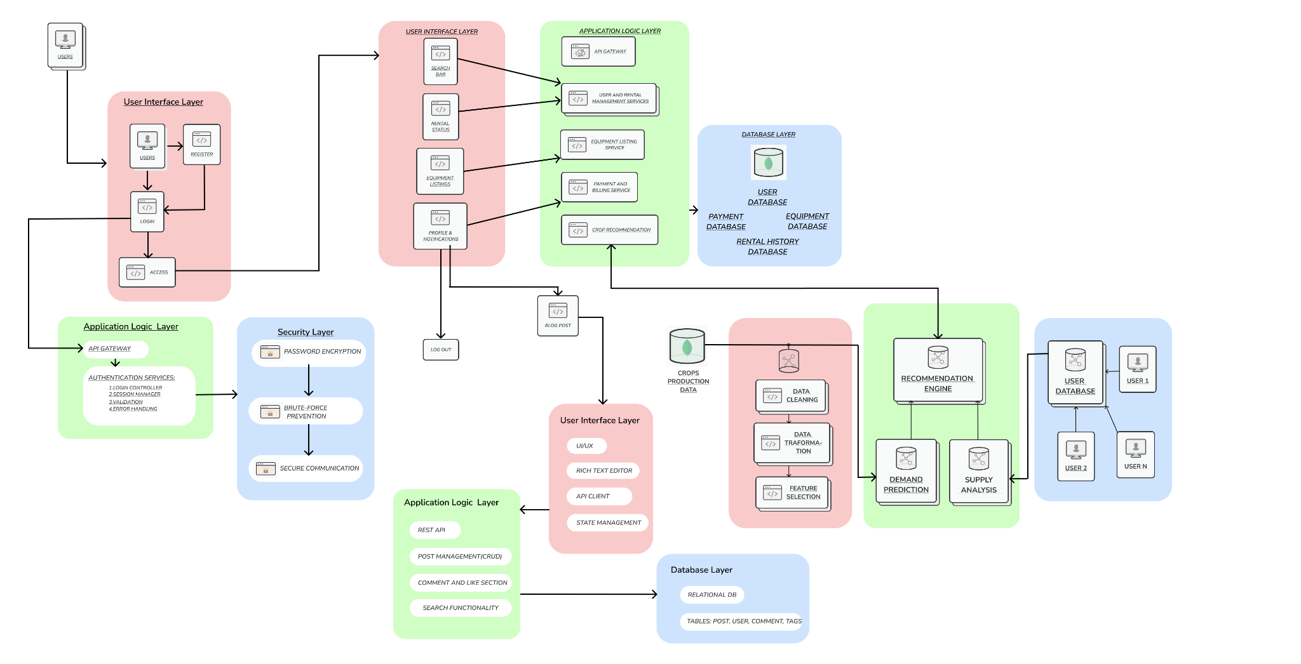
System Architecture

Slide 7
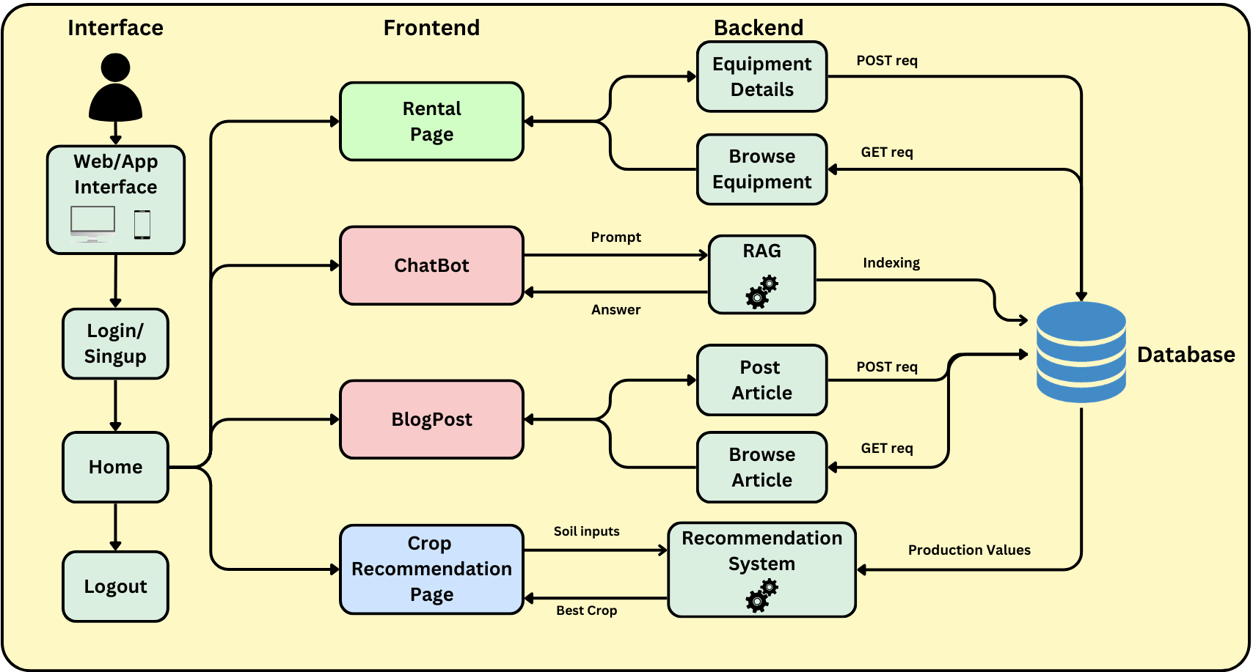
System Architecture

Slide 8
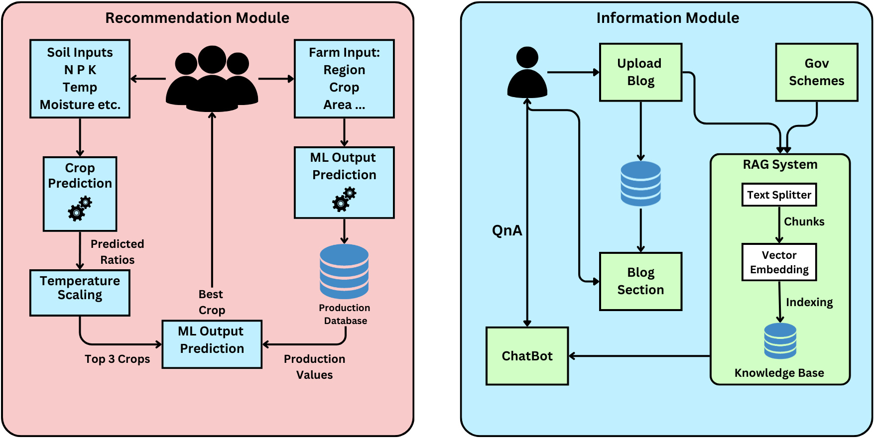
Algorithm

Slide 9
Timeline

Slide 10
References
Research Paper:
[1]Swain, K. P., Nayak, S. R., Ravi, V., Mishra, S., Alahmadi, T. J., Singh, P., & Diwakar, M. (2024). Empowering crop selection with ensemble learning and K-means clustering: A modern agricultural perspective. The Open Agriculture Journal, 18. https://doi.org/10.2174/0118743315291367240207093403
[2]Pan, J.J., Wang, J. & Li, G. Survey of vector database management systems. The VLDB Journal 33, 1591–1615 (2024). https://doi.org/10.1007/s00778-024-00864-x
[3]Shams, M.Y., Gamel, S.A. & Talaat, F.M. Enhancing crop recommendation systems with explainable artificial intelligence: a study on agricultural decision-making. Neural Comput & Applic 36, 5695–5714 (2024). https://doi.org/10.1007/s00521-023-09391-2
[4]Balanya, S.A., Maroñas, J. & Ramos, D. Adaptive temperature scaling for Robust calibration of deep neural networks. Neural Comput & Applic 36, 8073–8095 (2024). https://doi.org/10.1007/s00521-024-09505-4
[5]Wang, L., Yang, N., Huang, X., Yang, L., Majumder, R., & Wei, F. (2024). Improving text embeddings with large language models. https://thegenerality.com/agi/
[6]Swain K, Nayak S, Ravi V, Mishra S, Alahmadi T, Singh P, Diwakar M. Empowering Crop Selection with Ensemble Learning and K-means Clustering: A Modern Agricultural Perspective. Open Agric J, 2024; 18: e18743315291367. http://dx.doi.org/10.2174/0118743315291367240207093403
[7]Vani, P.S., Rathi, S. Improved data clustering methods and integrated A-FP algorithm for crop yield prediction. Distrib Parallel Databases 41, 117–131 (2023). https://doi.org/10.1007/s10619-021-07350-1
[8]Yoon, S.-H., Shin, J.-H., Kim, S.-W., Park, S., & Lee, J. B. (2012). Subject-based extraction of a latent blog community. Information Sciences, 184, 215–229. https://doi.org/DOI
[9]Dash, A., Awachar, M., Patel, A. et al. Open-Domain Long-Form Question–Answering Using Transformer-Based Pipeline. SN COMPUT. SCI. 4, 595 (2023). https://doi.org/10.1007/s42979-023-02039-x
APP/Website Links:
[10]FARMS: Farms machinery solutions: https://play.google.com/store/apps/datasafety?id=app.chcagrimachinery.com.chcagrimachinery&hl=en_IN&gl=US
[11]Jfarm Services:https: https://www.jfarmservices.in
[12]Dataset:https://www.kaggle.com/datasets/atharvaingle/crop-recommendation-dataset
[13]Github: https://github.com/Gladiator07/Harvestify

Slide 11
References
Research Paper:
[1]Swain, K. P., Nayak, S. R., Ravi, V., Mishra, S., Alahmadi, T. J., Singh, P., & Diwakar, M. (2024). Empowering crop selection with ensemble learning and K-means clustering: A modern agricultural perspective. The Open Agriculture Journal, 18. https://doi.org/10.2174/0118743315291367240207093403
[2]Pan, J.J., Wang, J. & Li, G. Survey of vector database management systems. The VLDB Journal 33, 1591–1615 (2024). https://doi.org/10.1007/s00778-024-00864-x
[3]Shams, M.Y., Gamel, S.A. & Talaat, F.M. Enhancing crop recommendation systems with explainable artificial intelligence: a study on agricultural decision-making. Neural Comput & Applic 36, 5695–5714 (2024). https://doi.org/10.1007/s00521-023-09391-2
[4]Balanya, S.A., Maroñas, J. & Ramos, D. Adaptive temperature scaling for Robust calibration of deep neural networks. Neural Comput & Applic 36, 8073–8095 (2024). https://doi.org/10.1007/s00521-024-09505-4
[5]Wang, L., Yang, N., Huang, X., Yang, L., Majumder, R., & Wei, F. (2024). Improving text embeddings with large language models. https://thegenerality.com/agi/
[6]Swain K, Nayak S, Ravi V, Mishra S, Alahmadi T, Singh P, Diwakar M. Empowering Crop Selection with Ensemble Learning and K-means Clustering: A Modern Agricultural Perspective. Open Agric J, 2024; 18: e18743315291367. http://dx.doi.org/10.2174/0118743315291367240207093403
[7]Vani, P.S., Rathi, S. Improved data clustering methods and integrated A-FP algorithm for crop yield prediction. Distrib Parallel Databases 41, 117–131 (2023). https://doi.org/10.1007/s10619-021-07350-1
[8]Yoon, S.-H., Shin, J.-H., Kim, S.-W., Park, S., & Lee, J. B. (2012). Subject-based extraction of a latent blog community. Information Sciences, 184, 215–229. https://doi.org/DOI
[9]Dash, A., Awachar, M., Patel, A. et al. Open-Domain Long-Form Question–Answering Using Transformer-Based Pipeline. SN COMPUT. SCI. 4, 595 (2023). https://doi.org/10.1007/s42979-023-02039-x
APP/Website Links:
[10]FARMS: Farms machinery solutions: https://play.google.com/store/apps/datasafety?id=app.chcagrimachinery.com.chcagrimachinery&hl=en_IN&gl=US
[11]Jfarm Services:https: https://www.jfarmservices.in
[12]

Slide 12
Thank You!

